Slide 1



Slide 2

Occlusion Culling in Alan Wake
Ari Silvennoinen
Notes:
I’m going to give a production oriented talk about occlusion culling and other performance increasing techniques implemented in Umbra that were used in the XBOX360 exclusive title, Alan Wake.
For the last five years I’ve been working as the principal programmer at Umbra Software and during the production of Alan Wake I was working very closely with the extremely talented team at Remedy.

Slide 3

Rendering Challenges in Alan Wake
Notes:
I’m going to start by showing a video that quite nicely demonstrates the rendering challenges that were unique to Alan Wake.
The game took place in a huge outdoor world inspired by the pacific northwest scenery, much like we have here in Vancouver. In addition to daylight scenes a lot of action took place after dark, featuring dynamic objects and local shadow casting light sources.

Slide 4

Introduction
Rendering challenges in Alan Wake
Large outdoor world
Dynamic objects
Local shadow rendering
Global shadow rendering
Umbra internals
Techniques and ideas used to tackle the rendering challenges
Umbra is the visibility middleware used in Alan Wake
Supports both hardware and software occlusion
Notes:
This talk is all about describing some of the rendering challenges in Alan Wake and what techniques and ideas are used inside Umbra, a middleware library for visibility optimization, to solve these problems.
The biggest rendering challenge was posed by the combination of the large outdoor world and dynamic lighting with adjustable time-of-day, dynamic shadows, atmospherical scattering and so on. Dynamic shadows with global light sources, such as the sun or the moon can become very expensive in scenes of this scale. Cascaded shadow maps provide a practical solution for managing shadow map aliasing with long view distances but it also increases the shadow map generation cost, since a shadow map must be generated for each cascade.
Other rendering challenges were the expensive local shadowed lights and scalable handling of dynamic objects, especially during the action sequences.

Slide 5
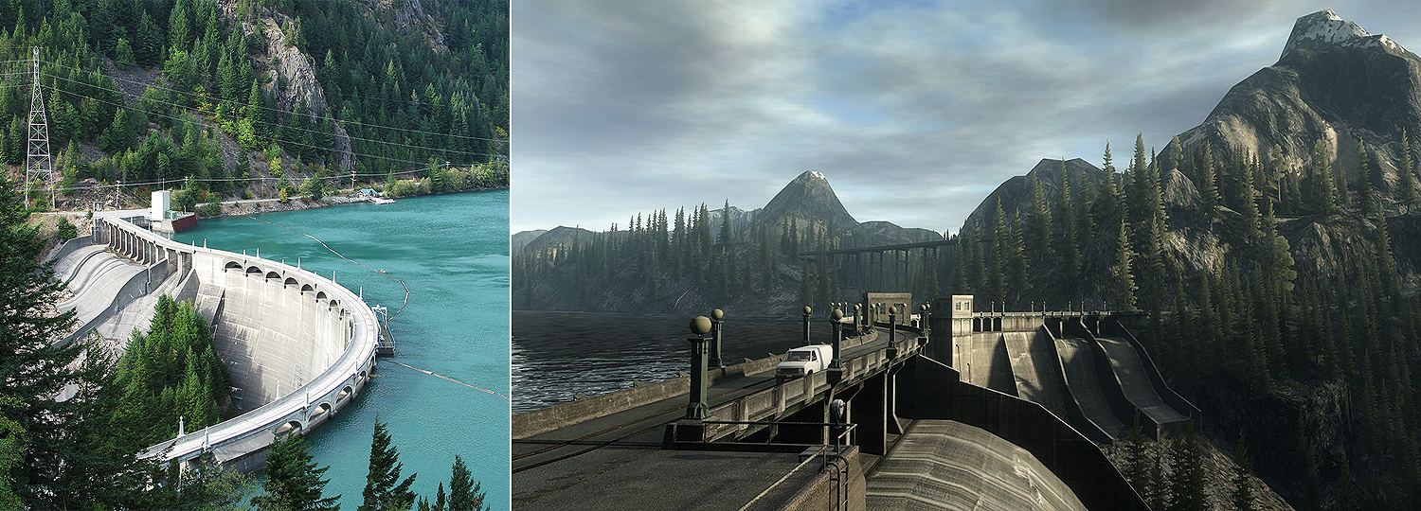
Large Outdoor Worlds
Occlusion Culling and LOD
Efficient data handling
Only a subset of the world fits in the memory
Notes:
Let’s take a closer look at the Alan Wake world. From the rendering perspective we basically know how we should handle large outdoor worlds. We can use occlusion culling to get rid of all the hidden objects and level-of-detail techniques to deal with the geometric and shading cost of the remaining visible objects.
A fundamental problem with large outdoor worlds and the current generation consoles is runtime data management. Only a subset of the world fits in the memory at any given time, so the Alan Wake engine is constantly streaming in geometry, textures, scripts and basically everything else you need to run the game.

Slide 6
Requirements for Visibility
Scalable culling (view frustum, distance and occlusion)
Out-of-core objects should be cheap
Efficient initial construction
Incremental updates for dynamic objects
Notes:
This sets some requirements for the visibility system and especially for the memory usage. First of all, we’d like to have a scalable solution for view frustum, distance and occlusion culling, which implies we need an object hierarchy. In addition, objects which are not loaded into memory should be very cheap, but, then again, the initial object hierarchy construction should be fast in order to avoid long level loading times. Finally, we want fast incremental updates for dynamic objects.

Slide 7
Umbra Architecture
Client
Umbra
Insert/Update
Spatial database
Query begin
Query traversal
Callbacks
Query end
Notes:
Let’s take quick tour of the Umbra visibility system. The architecture is based on a spatial database which provides the representation and update mechanics for the object hierarchy. The client issues a series of insert and update calls based on the game simulation state to construct and update the database. Visibility queries are then started from the client side and the query traversal interacts with the database. Visibility queries include for instance, view frustum culling, shadow frustum culling, occlusion culling, intersection queries and so on. In case of hardware occlusion culling, query traversal issues a series of callbacks to the client in order to notify that a hardware occlusion query should be issued or that some visible objects should be rendered to the depth buffer or that some results should be read from the GPU. At the end of the traversal the visibility is resolved and the traversal logic notifies the client through the callback mechanism. Note that Umbra delegates all rendering work to the client through the callbacks, which means that we remain platform independent.

Slide 8
Spatial Database
Axis-aligned BSP-tree with varying SAH split planes
Premultiplied OBB representation for objects
4x3 matrix for mapping the unit cube to world space OBB
Lazy update mechanism based on camera frustum
Mark nodes as dirty, update when actually traversed
Automatic amortized updates
Split plane optimization to improve spatial subdivision
Dead node cleanup to save memory on out-of-core locations
Notes:
Let’s take a closer look at the spatial database which plays a central role in the architecture. The spatial database is built on top of two key design principles: performance and low memory usage. We use an axis-aligned BSP-tree with varying split planes for the nodes as the core hierarchy. The split planes are chosen using a variant of the surface area heuristic. Objects are allowed to reside in multiple nodes, however we perform automatic split plane optimizations every frame to keep the tree reasonably balanced.
Objects are represented by their world space OBBs and we concatenate the object transform matrix and the OBB matrix to a single 4x3 matrix in order to save memory. In addition, we use a lazy update mechanism for the object insertions and updates and update the nodes only when they are actually traversed. This trick ensures that we don’t do any unnecessary work. Finally, in order to save memory and maintain a balanced tree structure we perform a small amount of automatic optimizations each frame, amortizing these costly operations over time.

Slide 9
Occlusion Culling
Hierarchical hardware occlusion culling
Avoiding latency by interleaving work
Umbra does hierarchy traversal and database update tasks to prevent CPU stalling
Works well in practice, however 100% utilization impossible due to GPU starvation
Avoiding latency by delayed reads
Artifacts!
Can not use full hierarchy -> not scalable
Notes:
For occlusion, Alan Wake used Umbras hierarchical hardware occlusion culling. The basic principle is very simple – the object hierarchy is traversed in a front to back order and each time a node is visited, you issue occlusion queries for it’s children before descending down the tree. Unfortunately this means a lot of back and forth communication between the CPU and GPU and this process effectively synchronizes their timelines leading to latency issues like CPU stalling and GPU starvation. CPU stalling can be eliminated by creating fine grained work tasks that the CPU can execute instead of spinning idle while waiting for the occlusion query result to become available on the GPU. In Umbra, we perform hierarchy traversal, accurate view frustum culling and database update tasks in order to minimize the CPU stalling. We have found that this works quite well in practice and this leads us to the second problem, which Is GPU starvation. No matter what you do, it’s basically impossible to feed the GPU to prevent starvation when the CPU and GPU are in synchronized because of driver batching and client side render setup always takes some amount of time.
The easy way out is to read the results back with one frame delay, avoiding all latency and timing issues. Now, this approach suffers from false occlusion which leads to popping and flashing artifacts when there are sudden changes in visibility. This fact prevents us from using the full hierarchy since otherwise the popping artifacts would be unbounded in screen space.

Slide 10
Occlusion Culling
Hybrid solution brings the best of both worlds
Screen space error bounds for artifacts
Adaptive query bounds
Some queries can be guaranteed to be ready with high probability
Keep the query count low
Queries are cheap but not free
Intelligent batching
Special rules for expensive objects
Notes:
These two approaches can be combined to build a scalable, hierarchical occlusion culling method. For latent queries, we can bound the potential error in screen space to an acceptable level and this allows us to use the hierarchy. For the remaining error, especially close to the camera, we use adaptive query bounds based on camera movement. This idea is based on the observation that we can compute conservative from region visibility in a very small neighborhood near the camera by growing the query bounds. This approximation is only useful for very small neighborhoods, since otherwise we loose too much occlusion power due to the enlarged bounds. Also, some queries that don’t affect traversal can be predicted to be ready with very high probability and this information can be applied to cull light sources for instance.
Regarding the performance, the single most important thing you can do is to reduce the query count, because although the queries are cheap, they are still quite fill-rate heavy. The basic mechanism that we apply here is batching. This means that we build a single bounding box for a group of nodes or objects and issue just a single occlusion query for the whole batch. We try to be somewhat intelligent on how we build the batches so we can maximize the probability that the batch doesn’t break up, because in that case we have to revert back to individual queries. Our heuristic is based on temporal and spatial coherence and we try to batch objects together when they have been invisible in roughly the same spatial location for some time. Finally, we use special rules for expensive objects, like light sources, to prevent batching and this way we can guarantee the best culling efficiency for those objects.

Slide 11
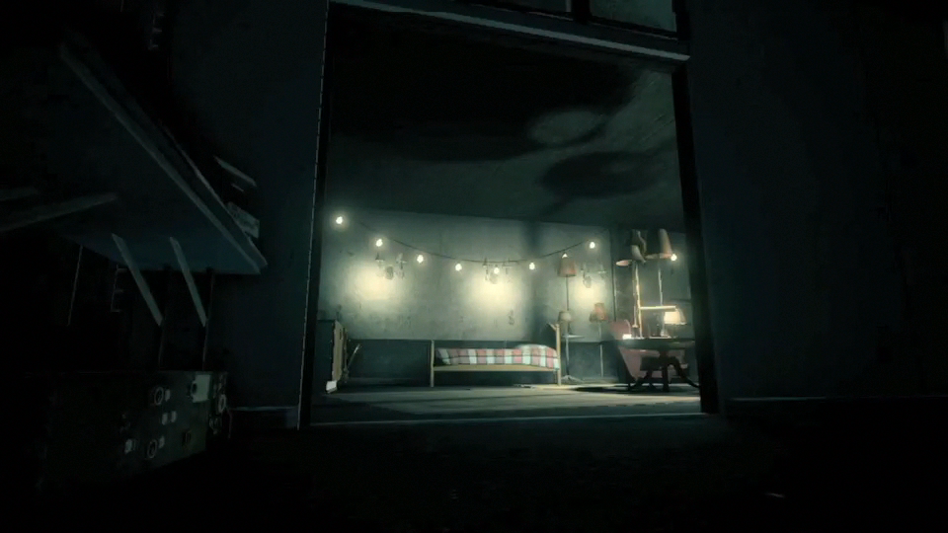
Occlusion Culling

Slide 12
Dynamic Objects
Dynamic objects live in the same database
Temporal bounding volumes
Linear prediction with conservative dynamics model
Stable and fast
Temporal bounds are AABBs
Has even been used with bullets driven by physics ☺
Take advantage of lazy and amortized updates
Keeps hierarchy balanced during movement
Ensures optimal node placement when object becomes static
Notes:
Because spatial database is built on the fly we treat all objects the same way so both static and dynamic objects live in the same database. As long as object has the same transformation matrix, we classify it as static and no extra work is needed. On the other hand, when we detect a change in the object transformation matrix we classify the object as being dynamic and compute a temporal bounding volume for the object, which is used instead of the original bound in the spatial database. Note that we still use the original OBB for view frustum culling and occlusion testing. Temporal bounding volumes are a great tool to reduce the amount of tree updates we have to perform during heavy action scenes. We use a linear prediction model, meaning that the AABB for future time is assumed to follow from linear movement. We have a simple dynamics model which grows or shrinks the temporal bound based on motion vector magnitude. This scheme ensures that when the object stops moving the temporal bound cools off after some time and we can classify the object as being static, after which we can throw away the temporal bound to save memory. It’s worth noting that our automatic tree balancing will ensure that the tree never gets too much off balance during since we are constantly optimizing nodes.

Slide 13
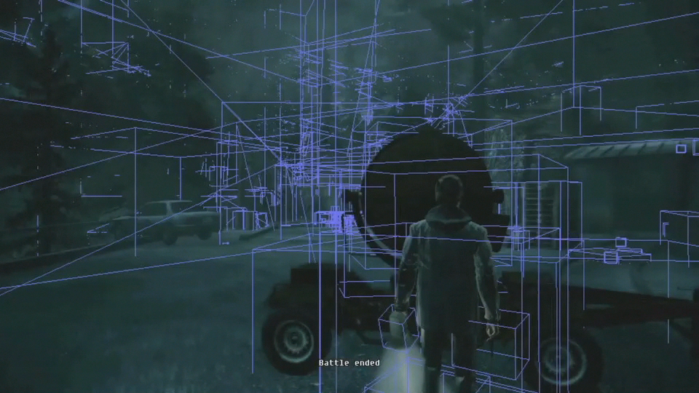
Dynamic Objects

Slide 14
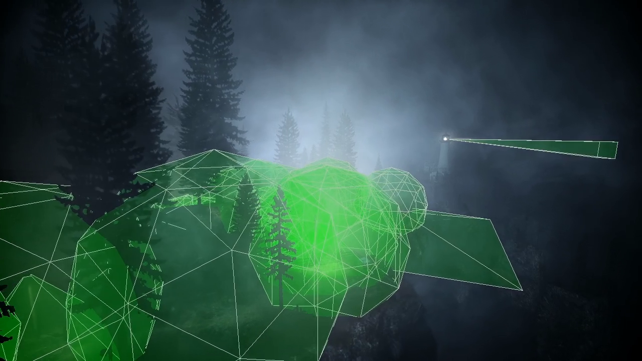
Local Shadows
Accurate bounding geometry
Spheres and frustums
Aggressive culling
Distance culling
Test every frame
No batching
Shadow casters use frustum culling
Notes:
During the night time scenes, Alan Wake uses a lot of local light sources. In some scenes the local lights cast shadows and they can become very expensive. In order to get best culling performance, we used special bounding geometry types designed for local light sources, spheres and frustums. Local light sources were also marked as expensive, so they were occlusion tested each frame and no batching was applied.

Slide 15
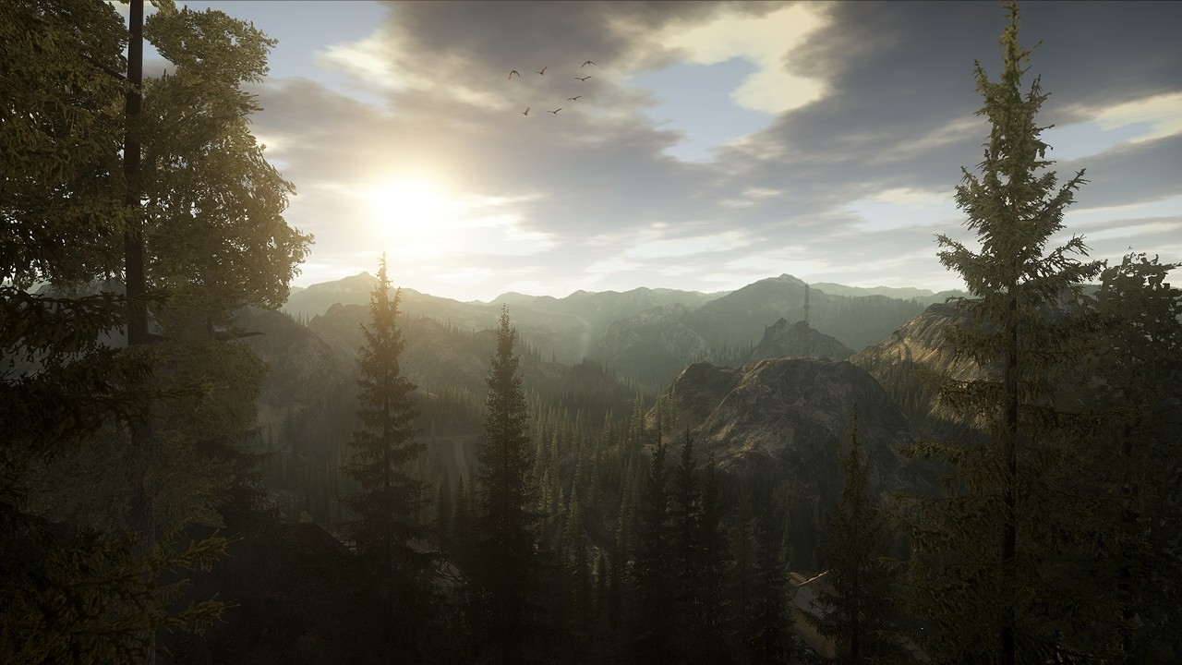
Global Shadows
Shadow map costs
Shadow map generation
Shadow map sampling + filtering
Lot of objects + cascaded shadows = high shadow map generation cost
What do we really need to draw to a shadow map?
Notes:
During the daytime scenes the cost of global shadows from the sun which, were rendered using cascaded shadow maps, were one of the biggest challenges. Shadow mapping costs can be split into two categories. First, we need to generate the shadow maps and the cost depends directly on the number of shadow casters we have to render. Second, when shading the scene we need to reconstruct the shadowing and for that purpose we sample and filter the shadow map. This step is independent of the number of shadow casters and the cost depends only on the chosen filtering scheme. In Alan Wake, we tried to minimize the shadow map generation cost, which was dominating the shadow map rendering time.
This naturally made us ask, what objects do we really need to draw to a shadow map.

Slide 16
Observation I
Cull objects in shadow
Notes:
Our first simple observation is that we can safely ignore all objects which are already in shadow. We can find out these objects by performing occlusion culling from the lights point of view. Alan Wake didn’t have a high depth complexity from the lights point of view, since most of the game took place outdoors, so there isn’t much to gain from identifying and culling this class of objects.

Slide 17
Observation II
Cull objects in which do not cast a visible shadow
Notes:
Our second simple observation is that we can safely ignore all objects which do not cast a visible shadow. This observation is more interesting, since it should help us a lot in the outdoor environment because do have a lot of occlusion going on. So, the next question is how can we identify and cull these objects.

Slide 18
Shadow Caster Culling
Use camera visibility to determine relevant shadow casters
Test each cascade for visibility
Check if the cascade contains any visible objects
Can potentially skip shadow map generation
Compute light space scissor rectangle for each cascade
Early geometry culling
These ideas generalize
Bittner et. Al, Shadow Caster Culling for Efficient Shadow Mapping, I3D 2011
Notes:
The key idea is to use camera visibility to determine the relevant shadow casters. In Alan Wake, we first solve the visibility from the camera’s point of view. The next step is to find out whether there are any visible shadow receivers in each of the cascades. If a cascade doesn’t contain any shadow receivers, we can safely skip the shadow map generation for the whole cascade, which is a huge win in certain scenarios. However, this is far from perfect since if the cascade contains even a single visible object, we need to generate the shadow map. To optimize these scenarios, we computed a light space bounding box of the visible objects for each cascade and used this to setup a tight scissor rectangle before rendering the shadow map. This gives us some speedup to the shadow map generation due to early geometry culling but we still have to pay for the transform cost.
After the game shipped we thought about these ideas further and came up with a practical algorithm for shadow caster culling. You can find more details from our I3D paper this year.

Slide 19
Cascaded Shadow Maps

Slide 20
Cascaded Shadow Maps

Slide 21
Cascaded Shadow Maps

Slide 22
Cascaded Shadow Maps
Small scissor
Empty cascade

Slide 23
Conclusions and Future Work
Efficient spatial database in a key role
Visibility-aware algorithms
Shadow caster culling
Streaming?
Simulation and AI?
Rethink visibility and spatial connectivity
See our slides from “Advances in Real-Time Rendering in Games” course
Notes:
To summarize this talk, we presented a visibility system design based on efficient spatial database and demonstrated the key ideas that power Umbra.
The single most important take home message is that many game related problems can be solved more efficiently or in a completely new way when we take visibility into account.
In the future we want to rethink visibility and spatial connectivity and how these concepts can be used in game development. We described our latest work in this area in a joint talk with Bungie last Monday as part of the “Advances in real-time rendering in games” - course, so if you’re interested in these things and missed the talk, you should check out the slides.

Slide 24
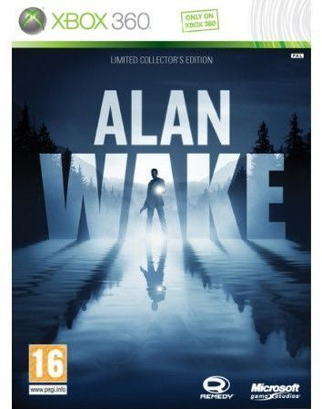
Thanks
Remedy Entertainment
Petri Häkkinen
Markus Mäki
Olli Tervo
Tuukka Taipalvesi
Colleagues at Umbra Software
Timo Aila
Ville Miettinen

Slide 25
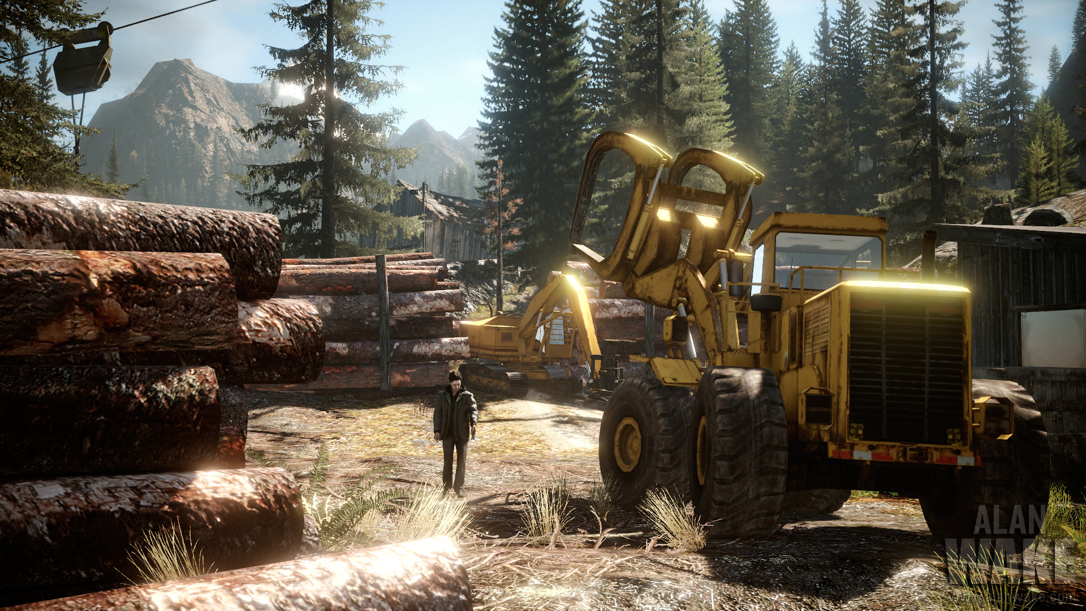
Questions?
Questions?

